Slide 1









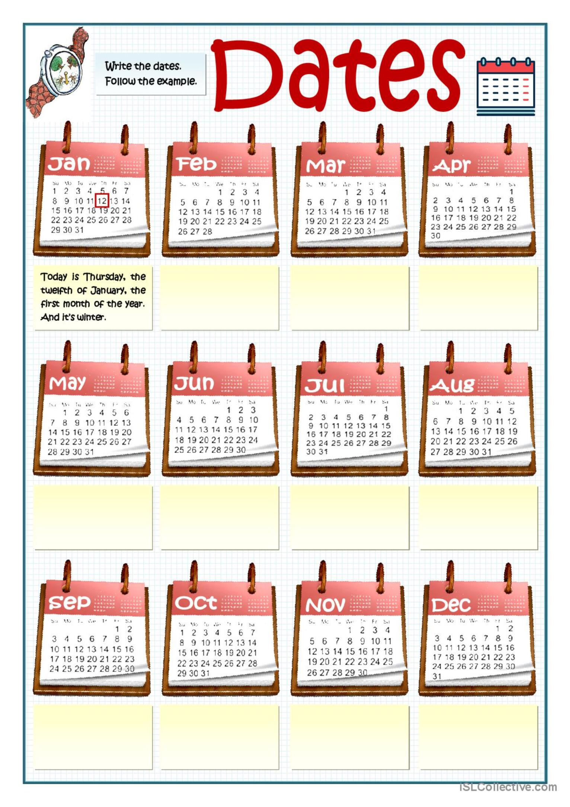






A1 Communication Coures
Lesson 7
Dates

Slide 2



TABLE OF CONTENTS
Pronunciation: /ɪə/ and /eə/
Exercises: /ɪə/ and /eə/
Speaking: Saying days and dates in English
Listening: How to say numbers, days and dates in English

Slide 3





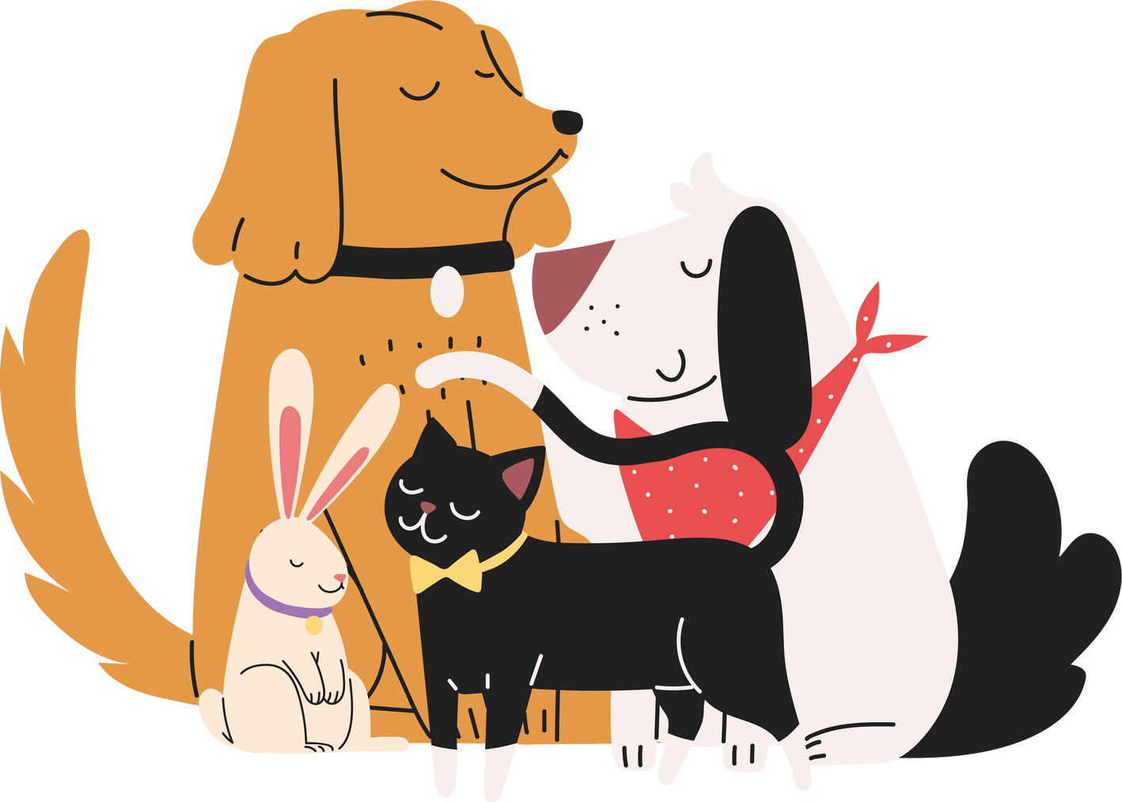




A.Pronunciation: /ɪə/ and /eə/

Slide 4


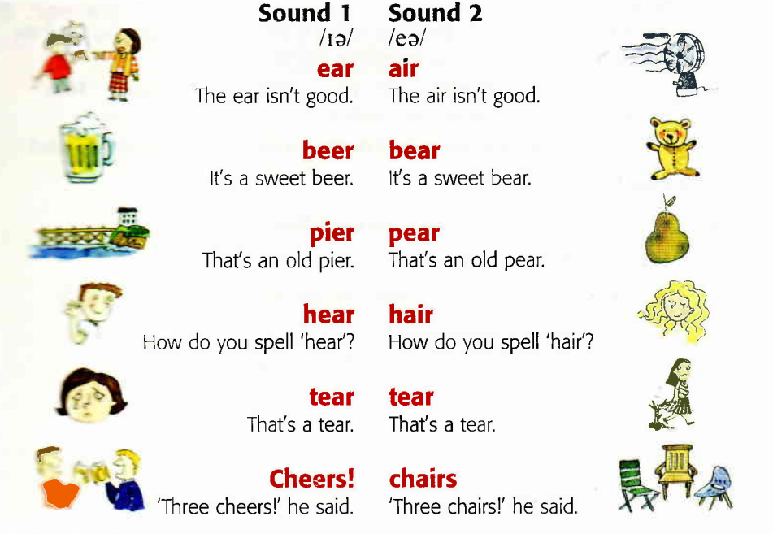





Pronunciation
Pronunciation : /ʊ/ and /u:/

Slide 5




Pronunciation Practice
Tick the words a) or b) that you hear in the sentences
1 | a) cheers | ⬜ | b) chairs | ⬜
2 | a) beer | ⬜ | b) bear | ⬜
3 | a) pier | ⬜ | b) pear | ⬜
4 | a) here | ⬜ | b) hair | ⬜
5 | a) dear | ⬜ | b) Dare | ⬜
6 | a) clear | ⬜ | b) Claire | ⬜

Slide 6
B.Exercises: /ɪə/ and /eə/

Slide 7
exercises
Exercises
Read this note and find
four /ɪə/ words and four /eə/ words.
Dear Mary, I’m really pleased you can come to the theatre with us tonight. We've got seats upstairs, near the front. See you there! Sarah
theatre
pleased
near
/ɪə/ 1 ……Dear……. 2 ……………… 3 ……………… 4 ………………
/eə/ 1 ……Mary……. 2 ……………… 3 ……………… 4 ………………
there
upstairs
Sarah
Listen to check your answers. Check with the Key. Then listen and repeat.

Slide 8
C.Speaking: Saying days and dates in English

Slide 9
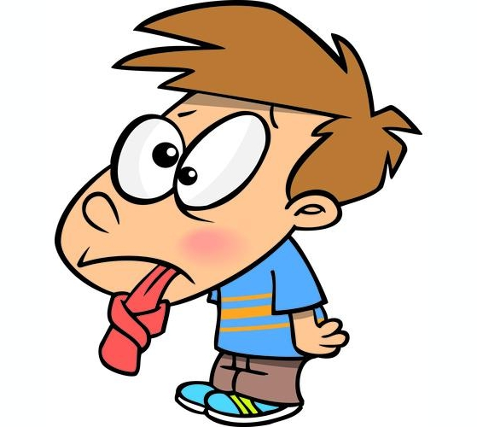
Day and Dates
Speaking
Task 1. Match the date with the words
1st second 13th twentieth
2nd twelfth 20th thirty-first
3rd fourth 21st thirtieth
4th fifth 22nd twenty-second
5th first 30th twenty-first
12th third 31st thirteenth
1st – first
2nd – second
3rd – third
4th- fourth
5th- fifth
12th - twelfth
13th – thirteenth
20th- twentieth
21st – twenty-first
22nd – twenty-second
30th – thirtieth
31st - thirty-first

Slide 10
Day and Dates
Speaking
Task 2. Listen and repeat.
First 2. second 3. third 4. fourth 5. fifth
6. sixth 7. seventh 8. eighth 9. ninth 10. tenth 11. twentieth 12. thirty-first
Task 3. Listen and circle the number you hear.
5th / 6th / 9 th 2. 2nd / 7th / 11th
3. 3rd / 11th / 30th 4. 7th / 10th / 11th

Slide 11
D.Listening

Slide 12
Day and Dates
Listening
Task 1. Match the questions 1- 4 to answer a-d.
Notice words in bold. Listen and check.
What day is it today? a. (It’s) the fifth of March
What’s the date today? b. (It’s) March the sixth.
What’s the date tomorrow? c. (It’s on) June the third.
4.When’s your birthday? d. (It’s) Wednesday.
1-d 2-a 3-b 4-c

Slide 13
Task 2. Listen to six conversations. What dates do you hear?
1 September 5th / 15th 4. July 2nd / 22nd
2 December 13th / 30th 5. October 13th / 30th
3 March 4th / 14th 6. February 1st / 5th

Slide 14
OVER TO YOU: WHEN'S YOUR BIRTHDAY?
Task 1: Move around the class and find your classmate's birthday.
Example:
A: When's your birthday?
B: It's on August 16th. When's your?
A: It's on ___________
Task 2: Work in pairs. Answer the question.
How many people……..? have their birthdays in the same month have a birthday this month have a birthday next month have the same birthday have the same birthday as you | Number _________ _________ _________ _________ _________

Slide 15





Jenny Nguyễn
Goodbye!

